Slide 1
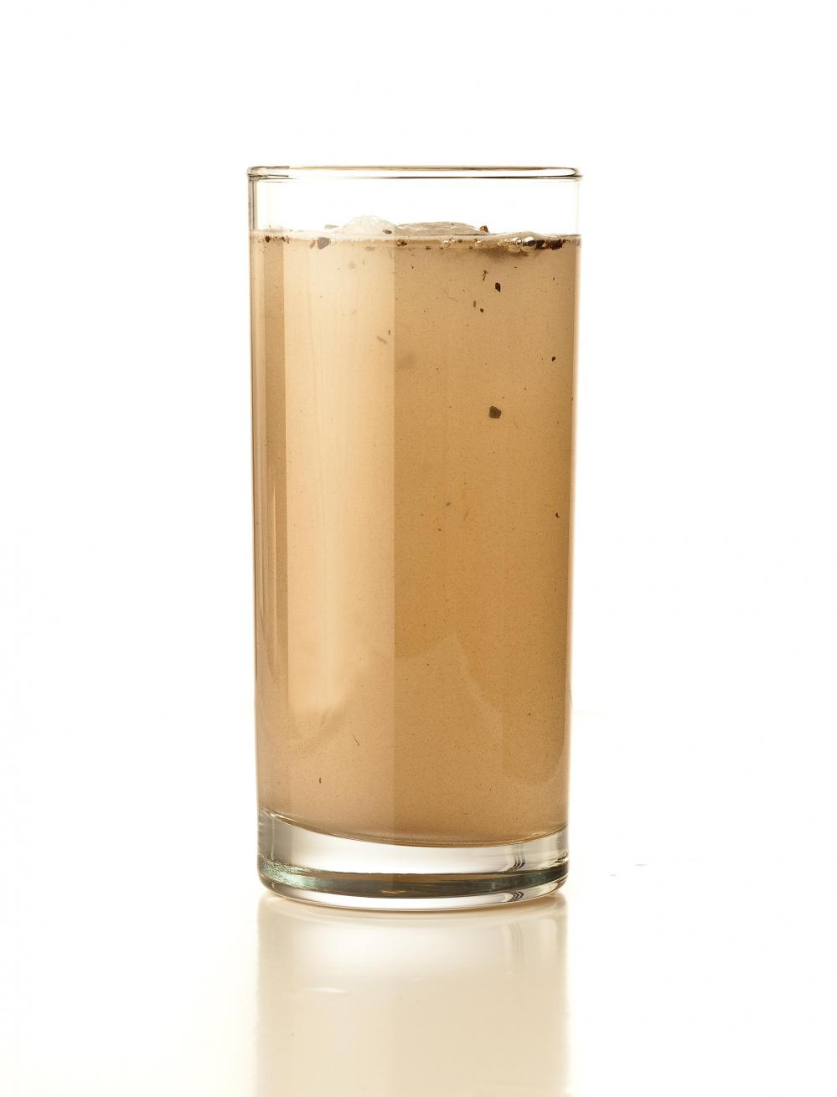

Refactoring Pre-compiler
Turning Water into Wine
Refactoring Rotten Code

Slide 2
Overview
Lab overview
We will be looking at bad code.
We will assume all code was not written by anyone here.
The BAD - code smells.
The GOOD – patterns and techniques.
Attendee code sharing opportunity (code review by committee)
Mix of presentation material, group exercises, and coding.

Slide 3
Turning Water into Wine
Workshop Schedule
Time | Section
8am-9:45am | Intro & Walkthrough
9:45am-10am | Break
10am-12pm | Code Smells
12pm-1pm | Lunch
1pm-1:45pm | Clean Code
1:45pm-2:45pm | Refactoring Techniques
2:45pm-3pm | Break
3pm-4pm | Attendee code sharing
4pm-5pm | Wrap-up

Slide 4
Turning Water into Wine
Lab facilitators
Patrick Delancy – DEG
Gabe Campbell - Epiq

Slide 5
Introductions
Name
Role and Where you Work
What do you want to learn?
Did you bring code?

Slide 6
Quotes
“Refactoring should never appear as a task on a schedule. Keeping code clean is just something that you do all the time.” - Uncle Bob Martin, Clean Code
"Refactoring changes the program in small steps. If you make a mistake, it is easy to find the bug." - Martin Fowler, Refactoring: Improving the Design of Existing Code
“Don’t leave “broken windows” (bad designs, wrong decisions, or poor code) unrepaired. Fix each one as soon as it is discovered.” - Andrew Hunt & David Thomas, The Pragmatic Programmer
“Red, Green, Refactor”
TDD

Slide 7
Refactoring – Why?
Why You Should Refactor
Code is never perfect on the first try.
(Business) needs change.
To remove excess code (DRY)
To remove dead code.
So you (and others) can understand it.
Move RISK.
Reduce technical debt.
Make it extensible.
Improve coding skills.

Slide 8
Refactoring – Why
Why You Shouldn’t Refactor
Legacy Code IS a minefield.
Don’t churn code – we don’t want to refactor/rewrite EVERYTHING!
Not tied to a new feature, improvement or bug fix.

Slide 9
A Tale of 2 Developers
Developer A (Partick) | Developer B (Grabe)
Does not refactor. | Refactors often.
Studies code, documents. | Refactors code to learn it.
Minimal code changes. | Major code changes.
90% time spent doing research. | 90% time spent coding.
Never causes regressive bugs. | Often causes regressive bugs.
Not a great coder. | Is the better coder (gives talks at KCDC)
Predictable amount of time spent. | Much more time spent.
Seen as a good employee. | Seen as a Risk.

Slide 10
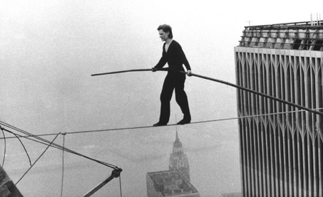
Refactoring vs. Hacking
Balancing act
When?
Risk?
Benefit?
Not immediately profitable
Benefits are long term.
Easier with well written code.
Most code is not well written.
Most code is difficult to refactor safely.

Slide 11
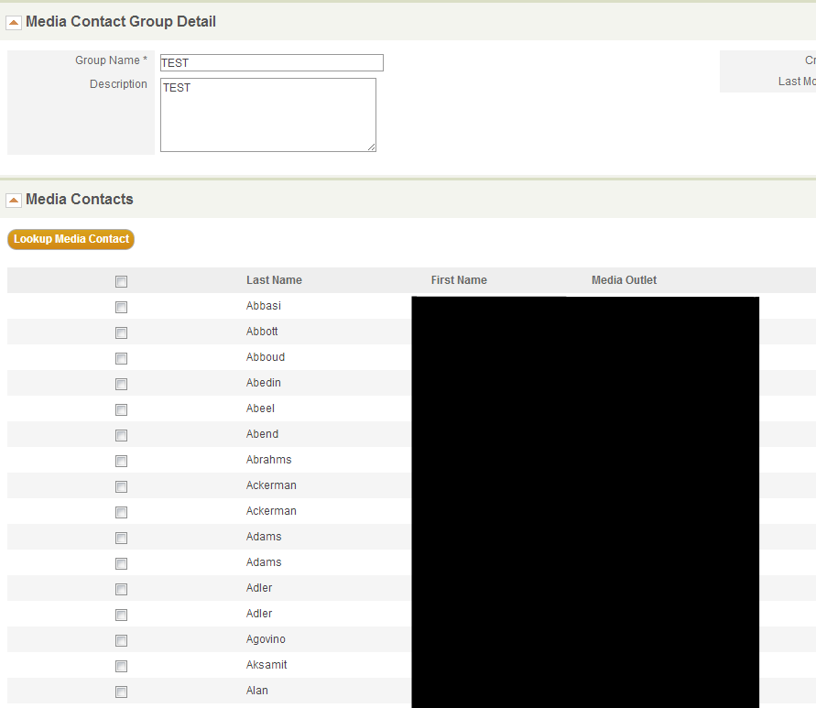
A real life case study

Slide 12
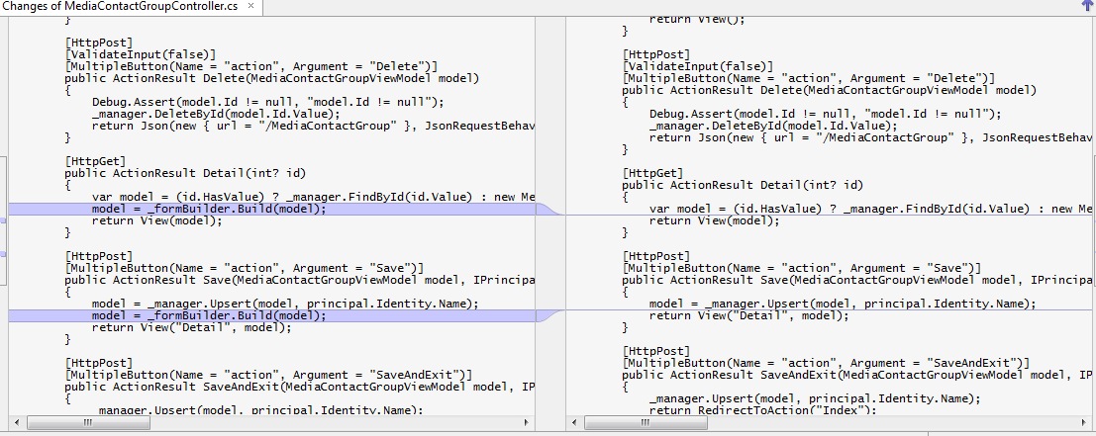
Performance improvement in another area of code

Slide 13
Unintentional Effects of Refactoring
Actual affects
Saving caused all MediaContacts to be removed from the Group.
31k of 36k records deleted.
Passed QA and client testing.
Users took 3 weeks to notice.
1 week to fix.
Most data recovered.
Lowered users confidence level.
Other projects suffer.

Slide 14
Reducing Risk
Ways to reduce risk when refactoring.
Tests! (Nunit, MSTest, etc)
Legacy code with no tests?
Integration -> Unit
Minimize impact area
Make non-destructive changes first (extracting methods/classes, renaming)
Ultimately it is up to you to manage RISK.

Slide 15

The Light at the End of the Tunnel
Code that is easy to maintain.
Code that is flexible to change.
Code that you want to re-use.

Slide 16
Road Map to success
Write code for other people.
Code review Often.
Share your code (OSS).
Make code understandable.
Project structure matters.
Class and method naming matters.
Method Signatures are your Road Signs.
Stay away from creating your own conventions.

Slide 17
Writing Clean Code
Don’t make fragile code.
Changing namespace or class names should never change behavior.
Learn to recognize and implement patterns.
Learn good techniques.
And learn when you’ve taken them too far…
http://thedailywtf.com/Articles/Self-Documenting.aspx

Slide 18
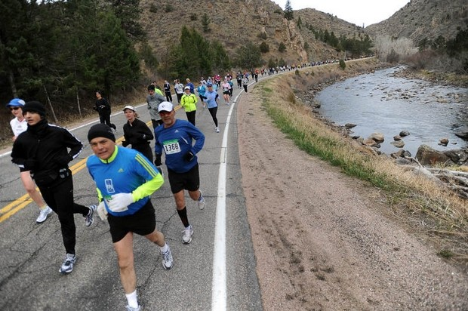
Who do you want to be?
What habits we create today
Make us who we are tomorrow

Slide 19

Finally..
Let’s get to it…

